Slide 1

Урок английского языка
4 А класс по теме
«Season and the weather»
Учитель иностранного языка
Мареева Ольга Михайловна
МБОУ СОШ №153

Slide 2
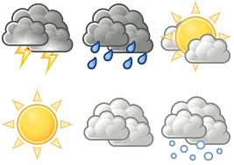
Whether the weather is fine, whether -ли
Or whether the weather is not, weather -погода,
Whether the weather is cold, выдержать
Or whether the weather is hot,
We`ll weather the weather,
Whatever the weather,
Whether we like it or not.

Slide 3
I like I dislike | spring summer autumn winter | because | it's It isn't I can I can't | cold and snowy hot and sunny rainy and cloudy warm and fine dive in the river make a snowman ride a bike | in spring in summer in autumn in winter

Slide 4
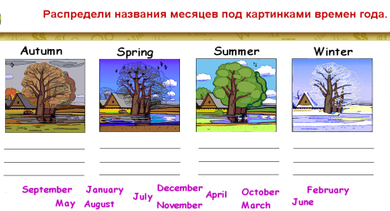

Slide 5
Present Simple You He We V She Vs They It I | Future Simple I, we shall V You, they, He, she, it will V
Формы глагола be в настоящем времени I am He,she,it is We,you,they are | Формы глагола be в будущем времени I,we shall be I,we,he, she, They,you will be | Модальный глагол can

Slide 6
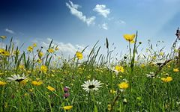
You put your right hand in, You put your right hand out; You put your right hand in,
And you shake it all ...
You put your left hand in,
your left hand out.
You put your left hand in
And you shake it all ...
You do the Hokey Cokey
and you turn around.
That’s what it’s all about!
You put your right hand in, You put your right hand out; You put your right hand in,
And you shake it all ...
You put your left hand in,
your left hand out.
You put your left hand in
And you shake it all ...
You do the Hokey Cokey
and you turn around.
That’s what it’s all about!

Slide 7

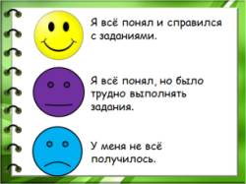

Slide 8
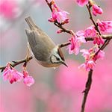

Homework:
Textbook
Write a letter p. 17, ex. 41 (35-50 words),

Slide 9


