Slide 1
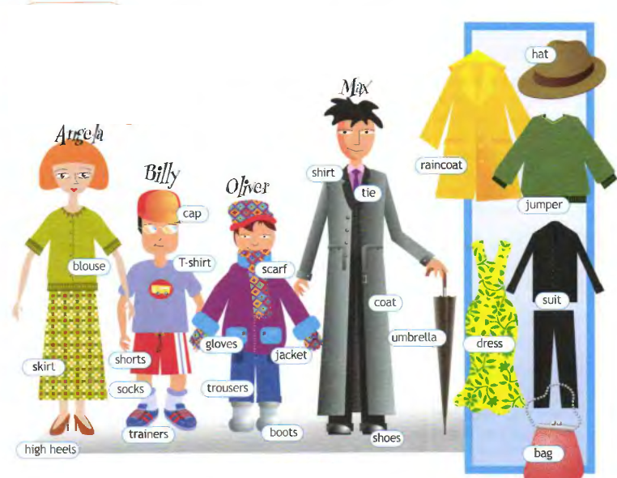
DRESS RIGHT
MODULE 7

Slide 2
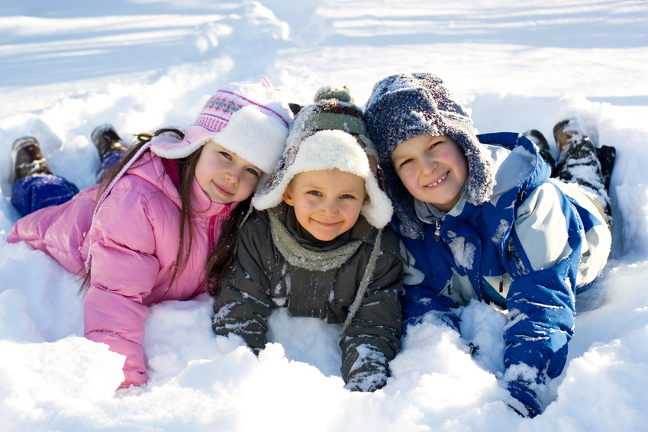
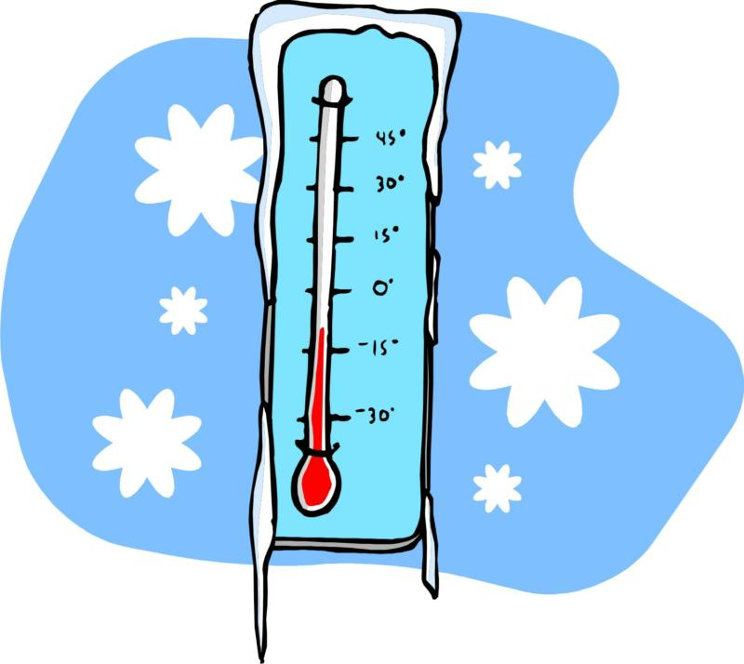
What is the weather like?

Slide 3
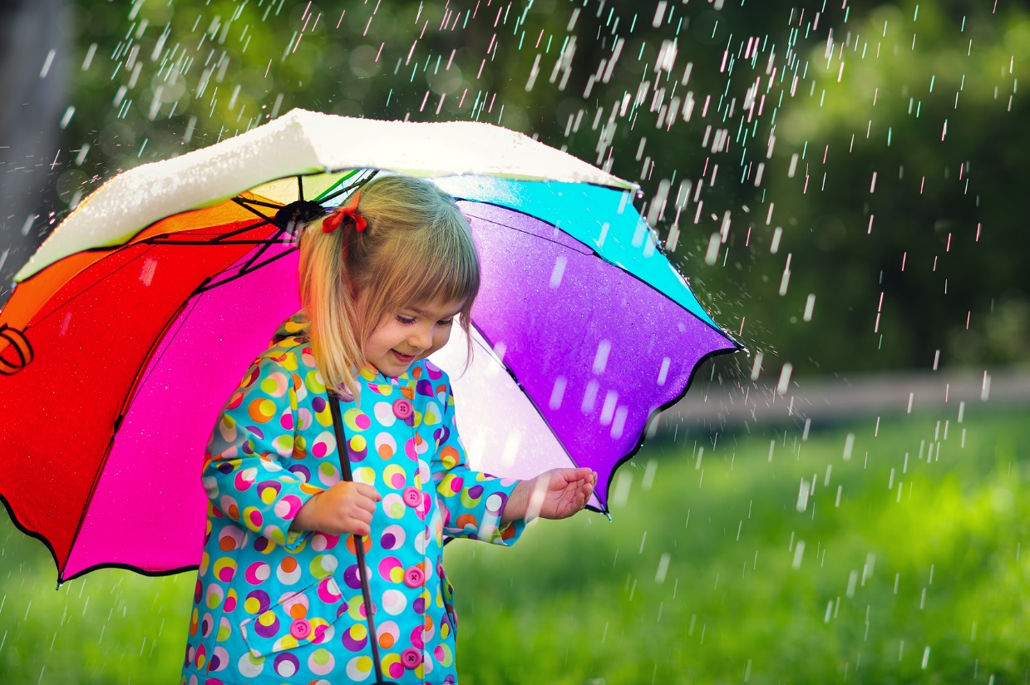
What is the weather like?

Slide 4
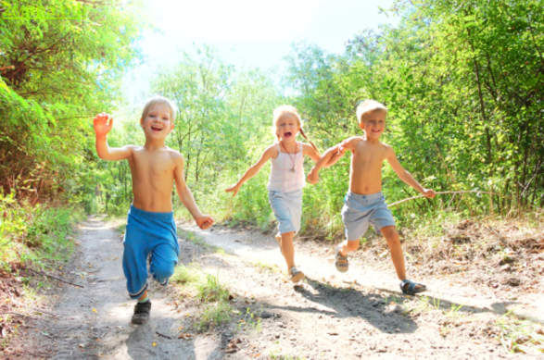
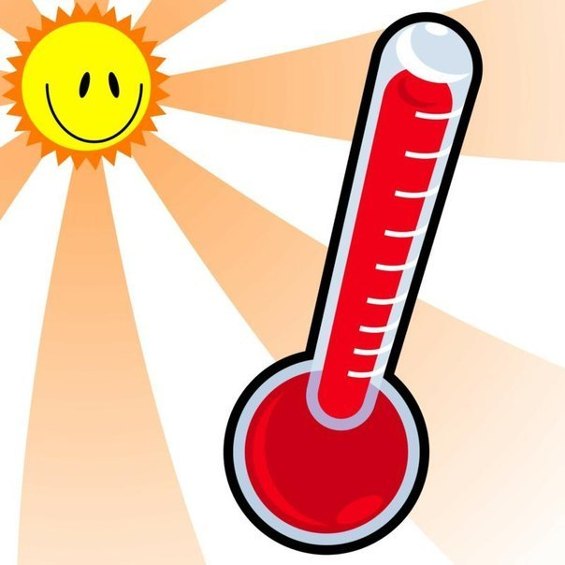
What is the weather like?

Slide 5
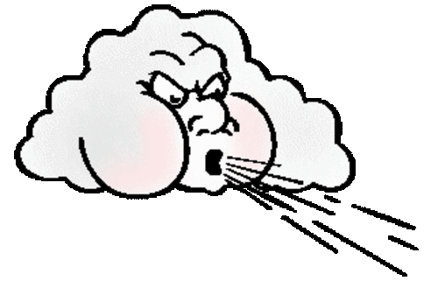
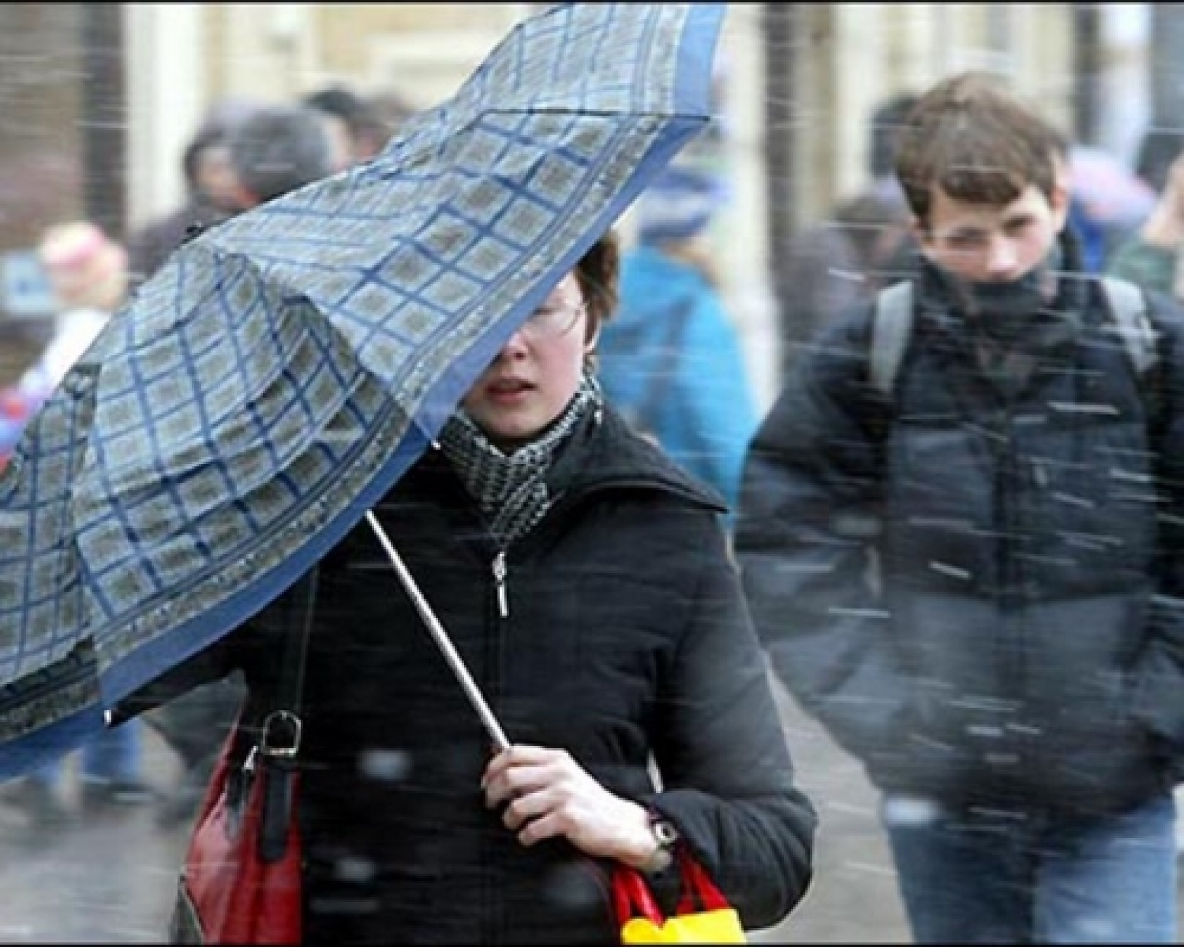
What is the weather like?

Slide 6
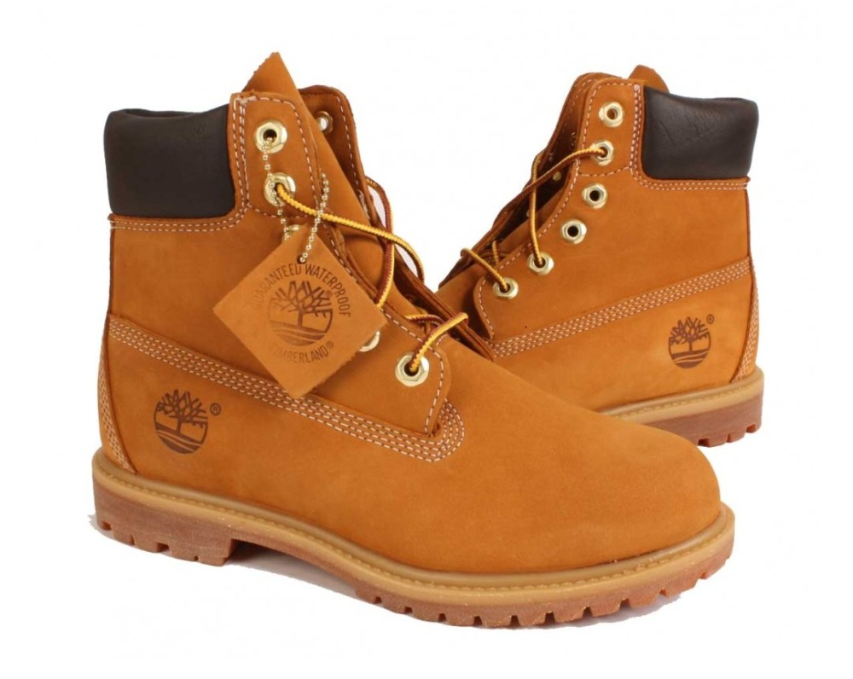
boots

Slide 7
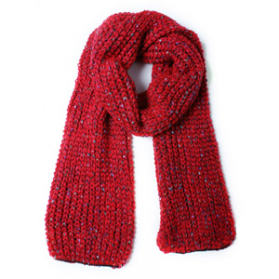
scarf

Slide 8
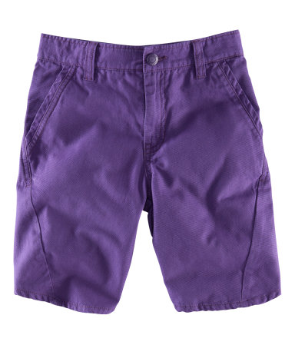
shorts

Slide 9
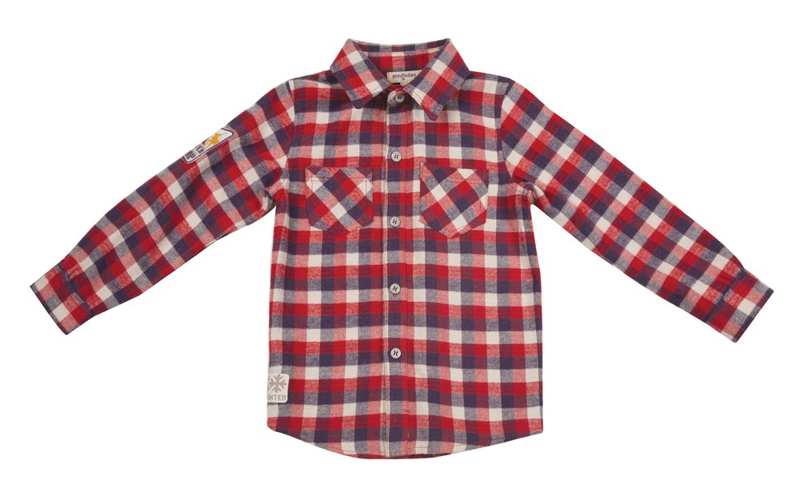
shirt

Slide 10
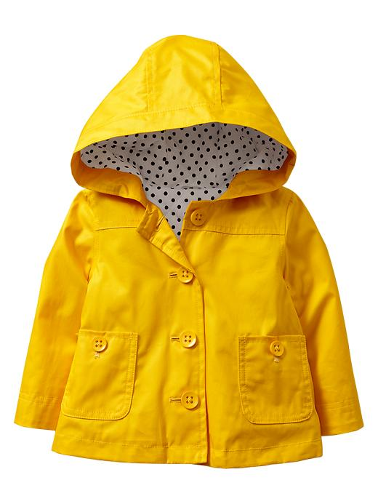
raincoat

Slide 11
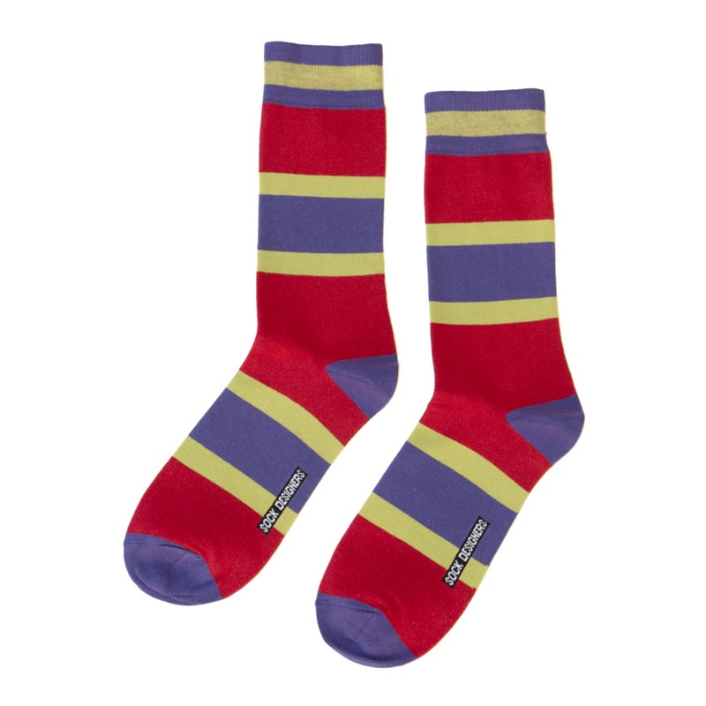
socks

Slide 12
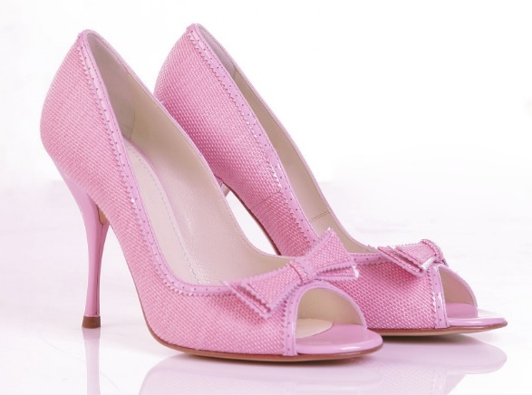
high heels

Slide 13
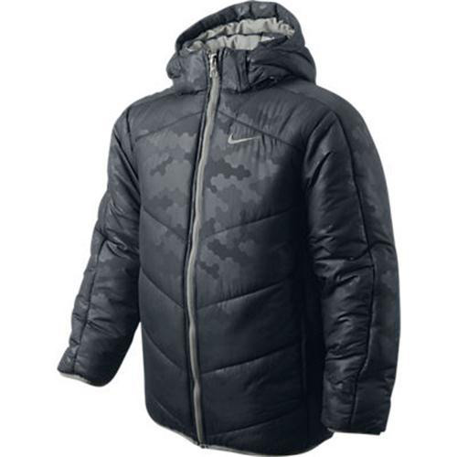
jacket

Slide 14
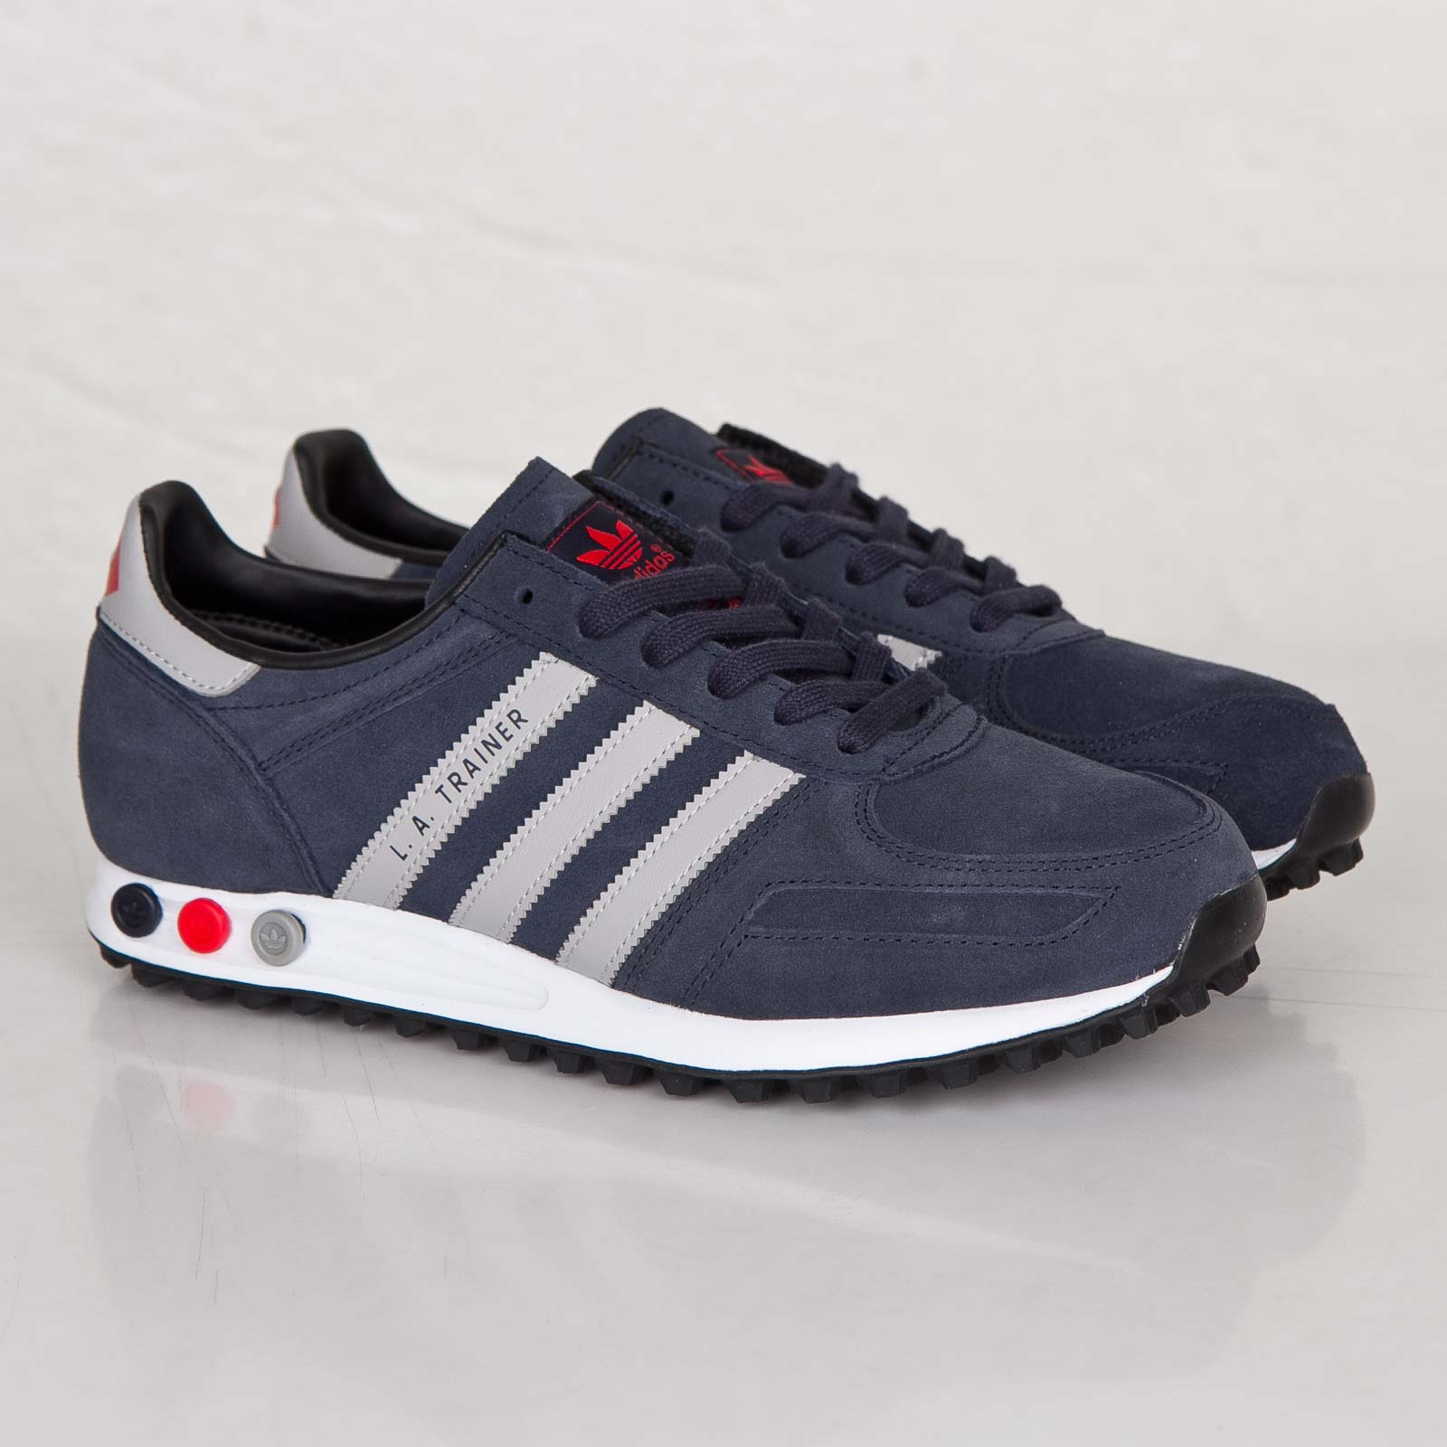
trainers

Slide 15
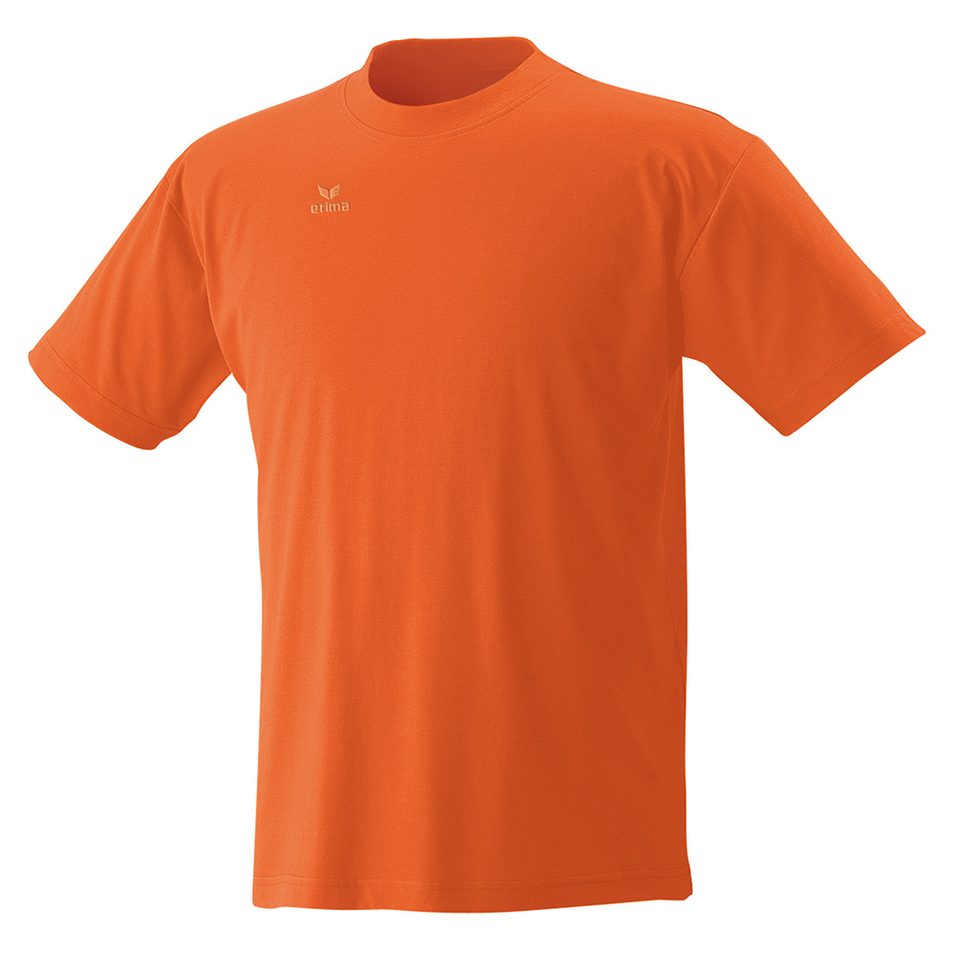
T-shirt

Slide 16
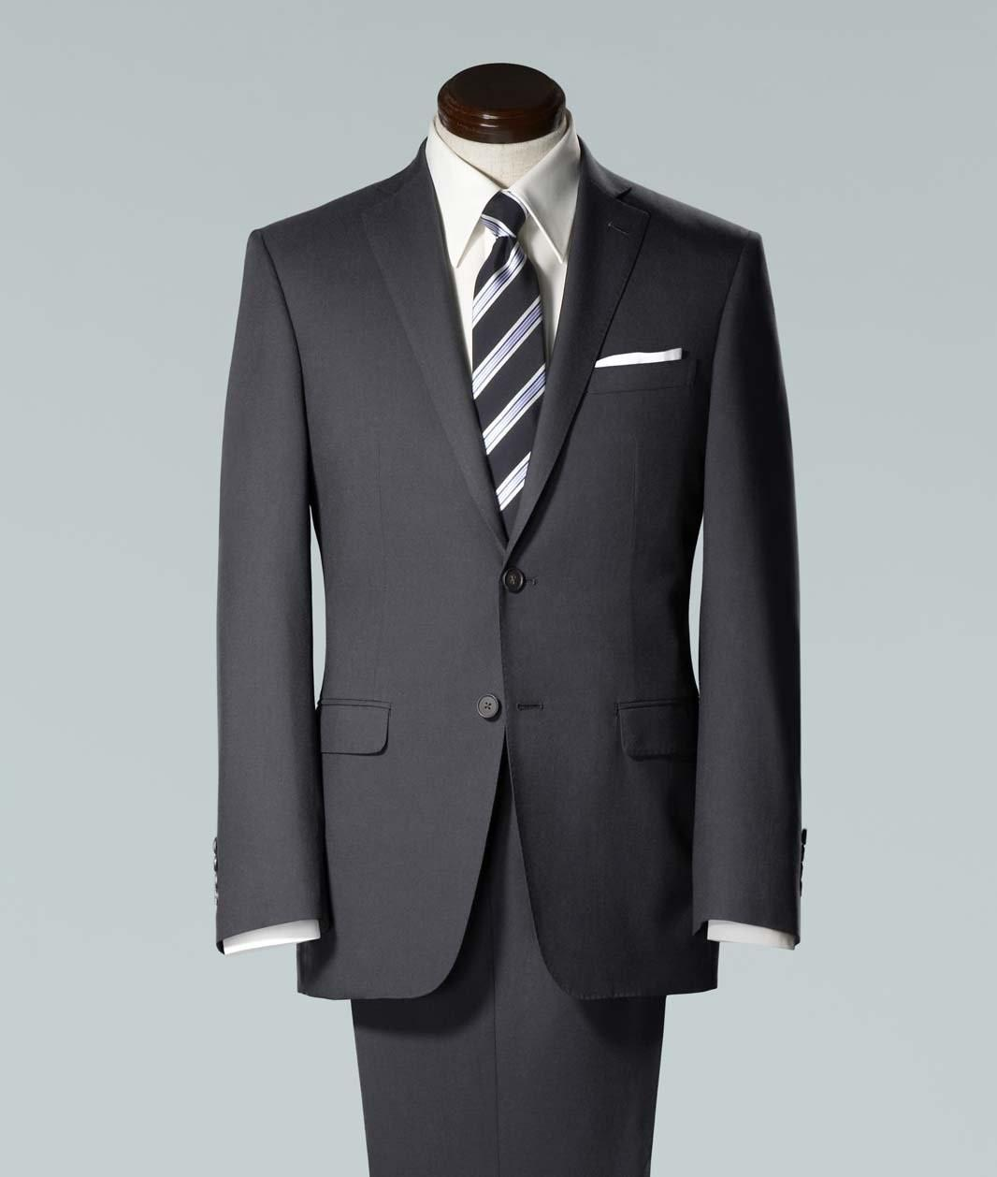
suit

Slide 17
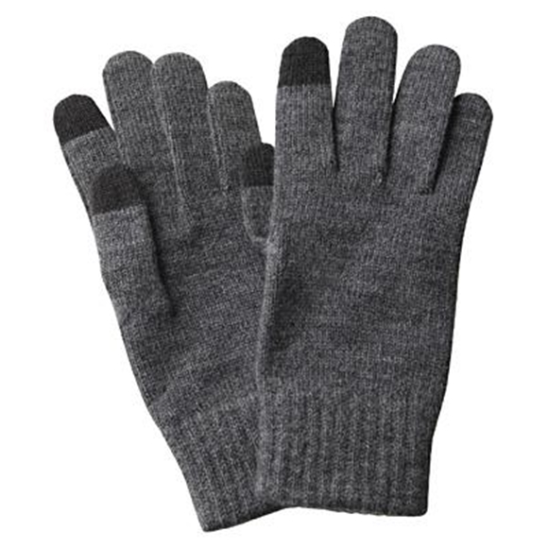
gloves

Slide 18
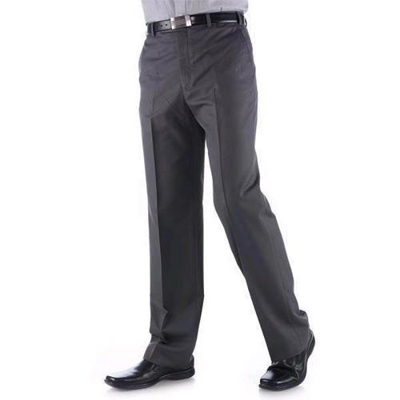
trousers

Slide 19
socks
gloves
warm clothes
skirt
jumper
T-shirt
trainers
blouse
shorts
dress
scarf
high heels
jacket
rubber boots
boots
shirt
suit
tie
coat
cap
hat
trousers
mittens
down-padded coat
umbrella
shoes
bag
raincoat

Slide 20
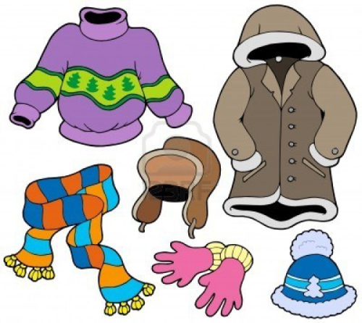
warm clothes

Slide 21
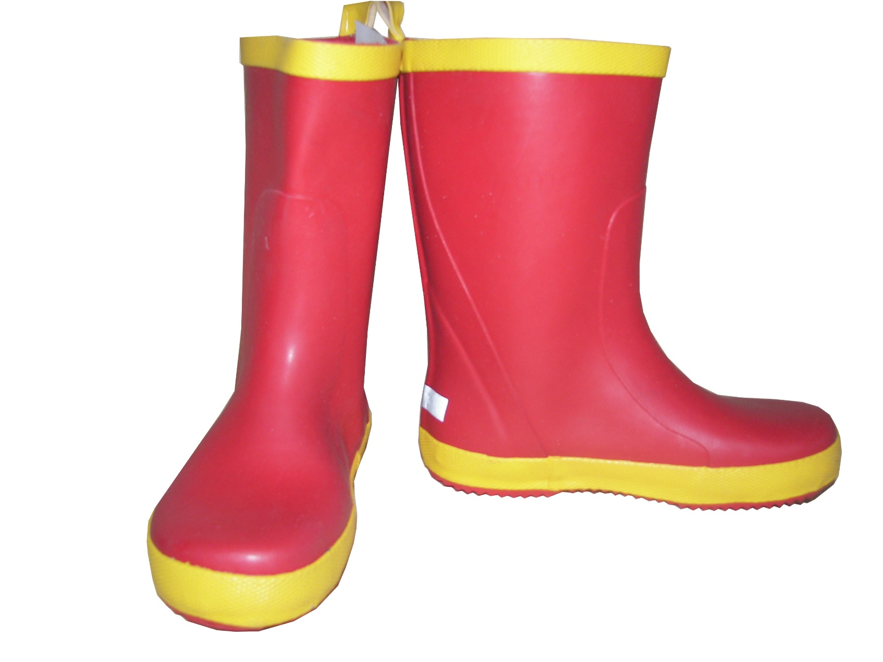
rubber boots

Slide 22
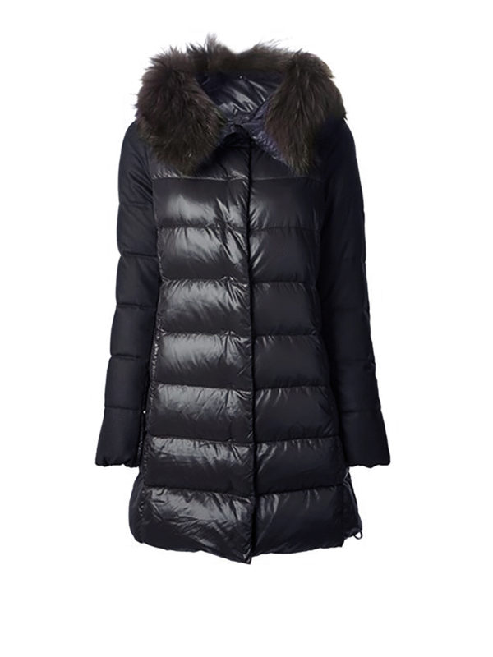
down-padded coat

Slide 23
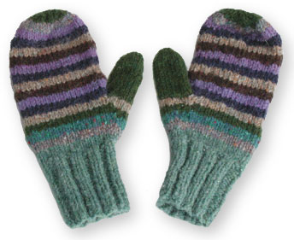
mittens

Slide 24
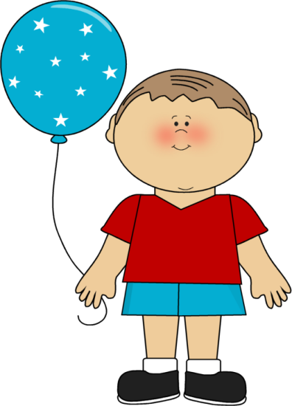
What is the boy wearing?
He is wearing a T-shirt, shorts,
socks and shoes.
What is the weather like?
It’s hot and sunny.

Slide 25
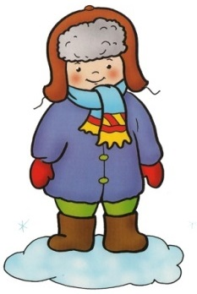
What is the boy wearing?
What is the weather like?

Slide 26
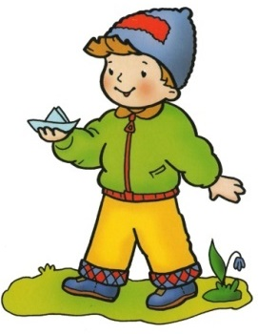
What is the boy wearing?
What is the weather like?

